Slide 1
WiFi Can Be the Weakest Link of Round Trip Network Latency in the Wild
Changhua Pei†, Youjian Zhao†, Guo Chen†, Ruming Tang†, Yuan Meng†, Minghua Ma†, Ken Ling‡, Dan Pei†
†Tsinghua University ‡Carnegie Mellon University

Slide 2
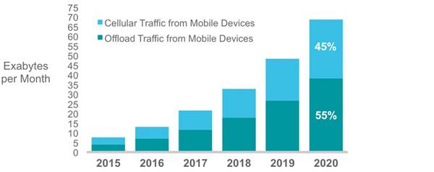
WiFi is indispensable in our daily lives!
Promoted by booming of the smartphones:
90% of the world’s population over 6 years old will have a mobile phone by 2020. [ERICSSON MOBILITY REPORT JUNE 2015]
Mobile offload > cellular in 2015 for the first time
Source: Cisco VNI Mobile, 2016
Notes:
http://www.statista.com/statistics/292859/north-america-mobile-data-traffic/
Mobile offload exceeded cellular traffic for the first time in 2015
Logic: increase in smartphones -> offload increase in smartphones -> real-time entertainment increase

Slide 3
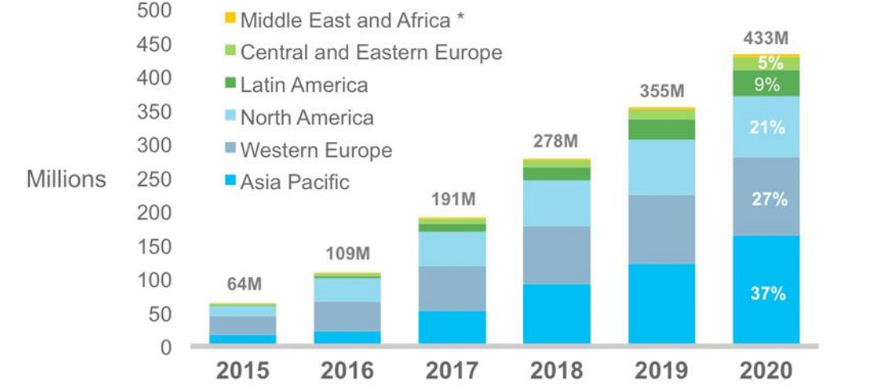
WiFi is indispensable in our daily lives!
Booming of the Access Points:
Number of Access Points!
Source: Maravedis, Cisco VNI Mobile, 2016
Notes:
http://www.statista.com/statistics/292859/north-america-mobile-data-traffic/
Mobile offload exceeded cellular traffic for the first time in 2015
Logic: increase in smartphones -> offload increase in smartphones -> real-time entertainment increase

Slide 4
WiFi performance is far from satisfaction
PAGE LOAD TIME
> 3 SECONDS
47%
LEADS TO
USERS
EXPECT
40%
PAGE LOAD TIME
< 2 SECONDS
USES WILL
ABANDON THE PAGES
Akamai study. http://goo.gl/2pwozG.
Notes:
INFOCOM 2016 folder delay-value.pdf
http://www-dualstack.akamai.com/html/about/press/releases/2009/press_091409.html

Slide 5
WiFi performance is far from satisfaction
1
1000
ms
LAST-MILE DELAY
increase
ms
PAGE LOAD TIME
increase
Bismark Paper: S. Sundaresan, N. Feamster, R. Teixeira, N. Magharei, et al. Measur-
ing and mitigating web performance bottlenecks in broadband access
networks. In ACM Internet Measurement Conference, 2013.
Notes:
INFOCOM 2016 folder delay-value.pdf
[1] Cisco. Cisco visual networking index: Forecast and methodology, 2013– 2018. CISCO White paper, pages 2013–2018, 2013.
[2] Akamai study. http://goo.gl/2pwozG.

Slide 6
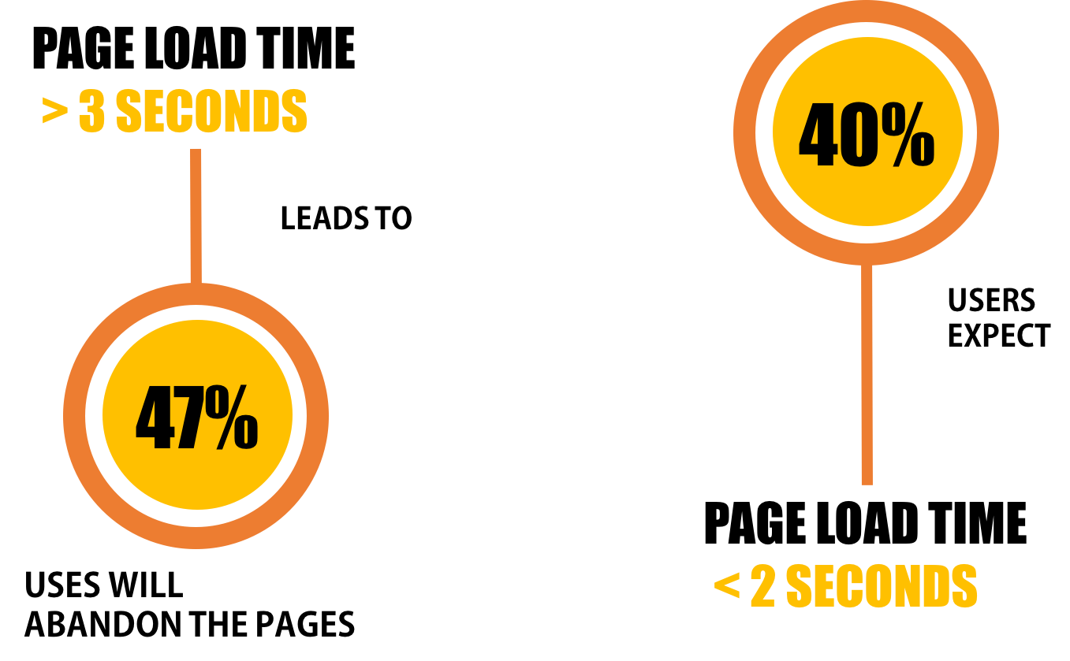
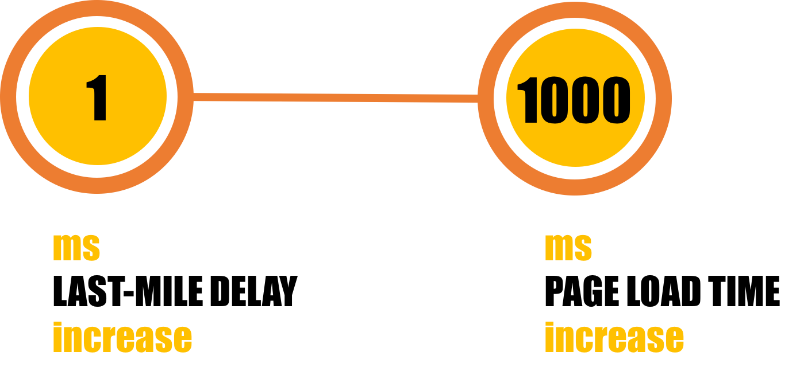
WiFi performance is far from satisfaction
Stringent Threshold: 20~30ms
Notes:
INFOCOM 2016 folder delay-value.pdf
[1] Cisco. Cisco visual networking index: Forecast and methodology, 2013– 2018. CISCO White paper, pages 2013–2018, 2013.
[2] Akamai study. http://goo.gl/2pwozG.

Slide 7

WiFi performance is far from satisfaction
Unsatisfied
25ms
Stringent Threshold: 20~30ms
Notes:
INFOCOM 2016 folder delay-value.pdf
[1] Cisco. Cisco visual networking index: Forecast and methodology, 2013– 2018. CISCO White paper, pages 2013–2018, 2013.
[2] Akamai study. http://goo.gl/2pwozG.

Slide 8

Challenge 1: Swiping the configurable parameters
Transmit Power?
Channel?
Location?
Channel
Width?
1
11
6
As large as Possible
1000mw!
Move closer to the AP!
No help to the
RSSI OF CLIENTS
measured on AP.
BLIND SEARCH !
Don’t know what
will happen.
CLIENTS MOVES !
Notes:
列出挑战性
But it is hard to reduce the wifi hop latency and there are many chanllenges.
The most common thing people can think up is swiping the configurable …, which including …
People can easily be confused by the blind searching because they don’t know what will happen if they change ….
Besides, increase the transmit power not always works because the transmit power is not equal to the rssi of clients which is measured on AP
And you can not always move the ap close to the clients because the clients always moves.

Slide 9
Challenge 2: Complex dependencies
Transmit Power?
Received signal strength on client-side
Airtime utilization
Location?
Packet loss
Transmitting physical rate
Channel?
Interference
Channel
Width?
…
Notes:
The second hard thing is that there are complex dependencies between different configurable parameters on AP.
We can see in the figure that transmit power will affect the rssi, so is the location.
the channel will affect the airtime utilization , so is channel width.
So how to pick the right parameters to reduce the latency is a tricky things for the AP owners.

Slide 10
Challenge 3: Trade-off
Higher RATE, Higher INTERFERENCE
Channel
Width?
Lower RATE , Less INTERFERENCE
There isn’t a single rule works for all scenarios!
Notes:
The third thing is that , there are many trade-off you must take into consideration when you make the decisions.
We take channel width as a example, if you choose a wider channel, you have larger possiblility to receive the higher
Physical rate, but it will also leads to higher interference. And vice versa
So we can see that it is hard things to tune the parameters at AP to reduce the wifi hop latency, and there isn’t a single rule woks for …
And our wok will focus on this and aim to help the AP owner reduce the wifi hop lantency more easily.

Slide 11

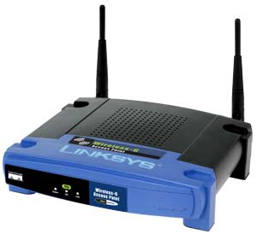
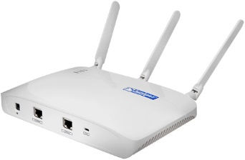
Our work
Systematic study
Guidelines for optimization
transmit power +10dbm
average latency -10%
Choose another channel
maximum latency -20%
…
…
Notes:
In our work, we aimed to provide some optimization guidelines after some systematic study of the AP.
The optimization may like the following two examples.
The first example is that after some studies , we suggest the AP owner increase the …. , and we predict that after this action, the average latency will decrease by 10 percent.
Another example is that user want to decrease the maximum latency by 20%, after diagnose using our system, we find that increase the
Transmit power does not help , but if choose another channel ,it will work.

Slide 12
Configurable
Parameters
WiFi Hop
Latency
WiFi Factors
…
Transmit Power?
Retry
Ratio
Airtime Utilization
Gap
Location?
Throughput
DELAY
Domain
Knowledge
Model
RSSI
Channel?
Physical
Rate
Queuing
Length
Channel
Width?
Notes:
列出是那些factors
The design principle of our work is simple, to fill the gap between … we continiously measure the WiFi hop factors, which including …
Than we set up the model to predict the wifi hop latency use this wifi factors.
As the relationship between the configurable … and wifi factors is well-studied and clear. We can easily map the wifi factors to the
Configurable parameters and our optimization work in the fillowing pages will show this detailly.

Slide 13
Predicting the Latency using WiFi factors
…
WiFi
Factors
WiFi Hop
Latency
Machine Learning
Predicting Model
Notes:
列出是那些factors
Because of the large amout of the wifi factors and complex non-linear relationship between factors and latnecy , ml is the ideal tool to predict the wifi hop latency.

Slide 14
Roadmap
How to accurately measure the WiFi hop latency?
How to predict the WiFi hop latency using WiFi factors effectively?
How to use this model to help AP owners to tune their APs?
Notes:
Util now , there are three things we need to do : the first is , the second the last .
We will answer this in the following sections.

Slide 15
Outline
Introduction
Methodology & Measurement
Analysis& Model
Optimization & Future Work

Slide 16
Measuring WiFi Hop Latency
Client
AP
Server
Using PING at client side: RTT = t₃-t₀
Packet Capture:
DL = t₃ – t₂’
t₀
UL
TCP SYN
t₁’
PL
client-side modification
t₁
WL+S
S
RTT
t₂
PL
t₂’
DL
TCP SYN-ACK
t₃
t₄’
TCP ACK
Time synchronization
t₄
Notes:
Here I first breaking down the round trip time at the view of the WiFi client

Slide 17
Measuring WiFi Hop Latency: our work
Use the latest 3-way handshake packet to approximate!
 | Delay Type | Description
3-way handshake packets | WL | t₂’-t₁’ | √
 | DL | t₃’-t₂’ | √
 | UL | t₄’-t₃’ | √
Data packets | WL | S | ×
 | DL | t₃’-t₂’ | √
 | UL | delay-ACK | ×
t₀
UL
TCP SYN
t₁’
PL
t₁
RTT
WL+S
t₂
PL
t₂’
DL
TCP SYN-ACK
t₃
t₃’
MAC Layer ACK
t₄’
TCP ACK
t₄
Notes:
To measure the DL, we make the driver modifications at the ap side. First we tag the packet when
After the mac layer ack turned back by the client, we will timestap the packet in the callback faction using t3 prime

Slide 18
Abbreviation | WiFi factors | Description | Generated By
AU | airtime utilization | % of channel time used by all the traffic | iw info
Q | queue length snapshot | Number of packets queued in hardware queue. | debugfs
RR | retry ratio | %packets retried in IEEE 802.11 MAC-layer. | iw info
RSSI | RSSI | Received signal strength of UE associated on AP. | iw info
T_{tx} | transmitting throughput | Bytes sent to UE every 10s. | ifconfig info
T_{rx} | receiving throughput | Bytes received from UE every 10s. | ifconfig info
RPR | receiving physical rate | Snapshot of physical rate for receiving packets from UE. | iw info
TPR | transmitting physical rate | Snapshot of physical rate for sending packets to UE. | iw info
Notes:
These are the wifi factors, which generate by the built-in openwrt

Slide 19
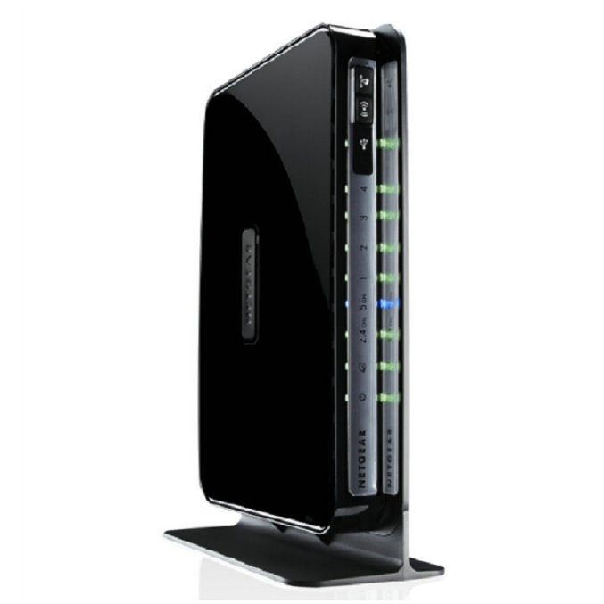
Data collection
Real deployment in Tsinghua University in China.
47 free Netgear WNDR4300 router equipped with Openwrt
44 in dormitory, 3 in department of computer science
Continuously collected from May 20th to July 20th
Collected about 2 terabytes raw data trace

Slide 20
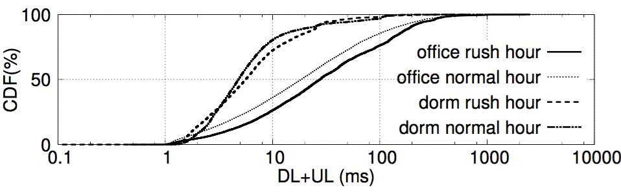
Office AP: 50%(10%) packets’
WiFi hop latency > 20ms(100ms)
Notes:
The first result we got is … of four overlapping categories

Slide 21
Rush hour: refer to measurement on Tsinghua campus by our group
Department Rush Hour:
16:00-17:00
Dormitory Rush Hour:
23:00-24:00
Sui, Kaixin, et al. "How bad are the rogues' impact on enterprise 802.11 network performance?." Computer Communications (INFOCOM), 2015 IEEE Conference on. IEEE, 2015.
Notes:
The rush hour is refererd to .. Our graph

Slide 22
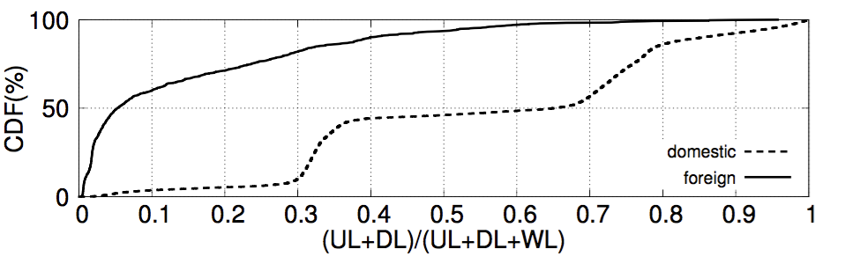
Measurement Result
For nearly 50% of the domestic packet, over 60% of the time is occupied by WiFi hop delay.
Domestic occupy over 98% of the whole packets.
Notes:
We also calculate the wireless ratio

Slide 23
Outline
Introduction
Methodology & Measurement
Analysis & Model
Optimization & Future Work

Slide 24
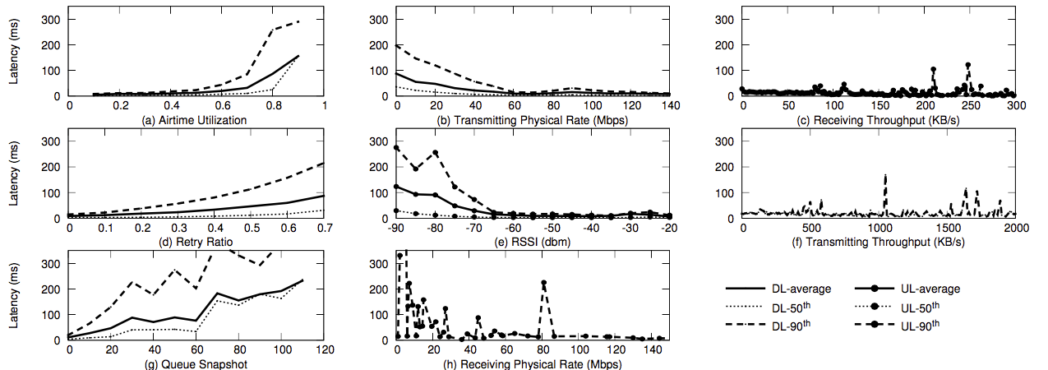
Visualization of the correlation
Positive Trends
Negative Trends
No Clear Trends
Airtime Utilization
Transmitting Physical Rate
Receiving Throughput
Retry Ratio
RSSI
Transmitting Throughput
Queue Snapshot
Receiving Physical Rate
Notes:
We also visualize the correlation between the latency and corresbonding factors.
Generally speaking ,t here are three

Slide 25
Visualization of the correlation
Positive Trends
Negative Trends
No Clear Trends
Airtime Utilization
Transmitting Physical Rate
Receiving Throughput
Retry Ratio
RSSI
Transmitting Throughput
Queue Snapshot
Receiving Physical Rate
Notes:
We also visualize the correlation between the latency and corresbonding factors.
Generally speaking ,t here are three

Slide 26
Visualization of the correlation
Positive Trends
Negative Trends
No Clear Trends
Airtime Utilization
Transmitting Physical Rate
Receiving Throughput
Retry Ratio
RSSI
Transmitting Throughput
No strong effect on WiFi hop latency when :
AU < 0.5 or TPR > 60 Mbps or RSSI > -60 dbm
Queue Snapshot
Receiving Physical Rate
Notes:
Another result we can get is that

Slide 27
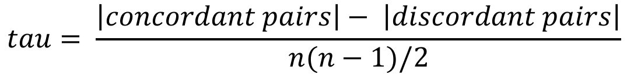
Correlation Analysis
Quality Metric | Kendall | RIG
AU | 0.86 | 0.05
RSSI | -0.5 | 0.06
RR | 0.4 | 0.08
TPR | -0.3 | 0.11
RPR | -0.2 | 0.09
T_{rx} | -0.17 | 0.01
Q | 0.15 | 0.007
T_{tx} | -0.006 | 0.02
Kendall correlation: (Kendall)
AU has few outliers
Relative Information Gain: (RIG)
how much a factor helps to predict the final latency
$$tau= \frac{\left|concordant pairs\right|− \left|discordant pairs\right|}{n(n−1)/2}$$
Notes:
We also give the quatification result of the correlaton， we use
Number of concordant pairs minus number of discordant pairs
Ken’ kao deng te

Slide 28
Correlation Analysis
Quality Metric | Kendall | RIG
AU | 0.86 | 0.05
RSSI | -0.5 | 0.06
RR | 0.4 | 0.08
TPR | -0.3 | 0.11
RPR | -0.2 | 0.09
T_{rx} | -0.17 | 0.01
Q | 0.15 | 0.007
T_{tx} | -0.006 | 0.02
TPR is the best choice to present the latency. This is because of the rate adaption algorithm.
Notes:
The second

Slide 29
Correlation Analysis
Quality Metric | Kendall | RIG
AU | 0.86 | 0.05
RSSI | -0.5 | 0.06
RR | 0.4 | 0.08
TPR | -0.3 | 0.11
RPR | -0.2 | 0.09
T_{rx} | -0.17 | 0.01
Q | 0.15 | 0.007
T_{tx} | -0.006 | 0.02
AU is not the best choice (largest RIG) because majority of packets’ AU < 0.5 which does not affect the latency that much.
Notes:
We can also see that

Slide 30
Correlation Analysis
Quality Metric | Kendall | RIG
AU | 0.86 | 0.05
RSSI | -0.5 | 0.06
RR | 0.4 | 0.08
TPR | -0.3 | 0.11
RPR | -0.2 | 0.09
T_{rx} | -0.17 | 0.01
Q | 0.15 | 0.007
T_{tx} | -0.006 | 0.02
Q provided by the debugfs is inaccurate, which remind us to use it carefully.
Notes:
The last thing we can learn

Slide 31
Decision Tree
( AU, RR, RSSI, T_{rx}, T_{tx}, TPR, RPR)
SLOW/FAST
Decision Tree
Predicting Model
Notes:
We choose the decision tree to predict the wifi hop latency

Slide 32
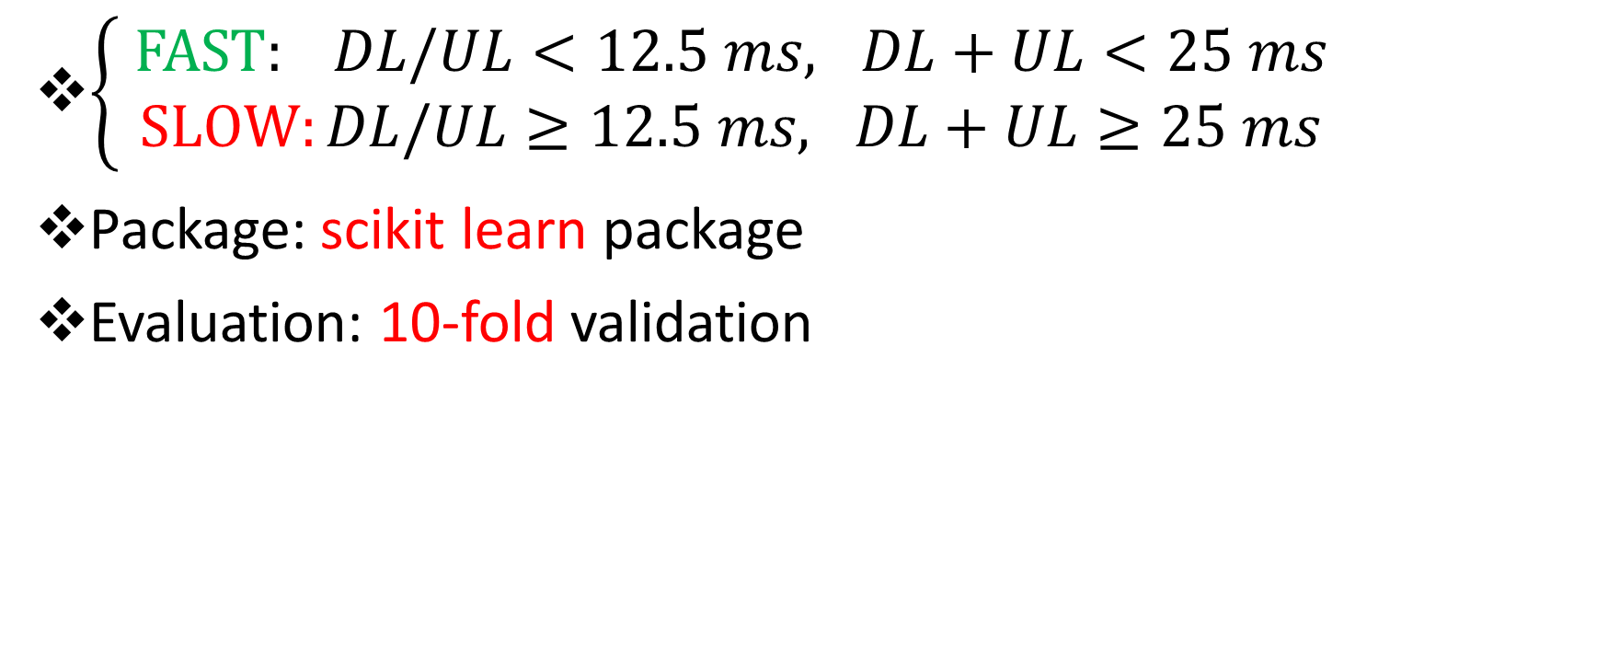
Decision Tree
$\left\{\begin{aligned} FAST: DL/UL<12.5 ms, DL+UL<25 ms \\ SLOW:DL/UL≥12.5 ms, DL+UL≥25 ms\end{aligned}\right.$
Package: scikit learn package
Evaluation: 10-fold validation
Notes:
We classified the latency into fast and slow categories using stringent threshold

Slide 33
Decision Tree
Method | Latency Type | Accuracy | Truth Positive Rate | False Positive Rate
Decision Tree | DL | 0.78 | 0.76 | 0.24
 | UL | 0.68 | 0.67 | 0.27
 | DL+UL | 0.77 | 0.79 | 0.31
DL: Direct measurement
UL/UL+DL: approximating using the latest 3-way handshake packet. (avoid delay-ACK mechanism)
Notes:
This is the accuracy evaluation of our model

Slide 34
Decision Tree
Method | Latency Type | Accuracy | Truth Positive Rate | False Positive Rate
Decision Tree | DL | 0.78 | 0.76 | 0.24
 | UL | 0.68 | 0.67 | 0.27
 | DL+UL | 0.77 | 0.79 | 0.31
The Random Forest, ( tree number = 200, tree depth = 100), Accuracy > 0.8 with 0.21 False Positive Rate for DL.
Why Decision Tree instead of Random Forest?
interpretability + usability
Notes:
We also try the random forest as comparision

Slide 35
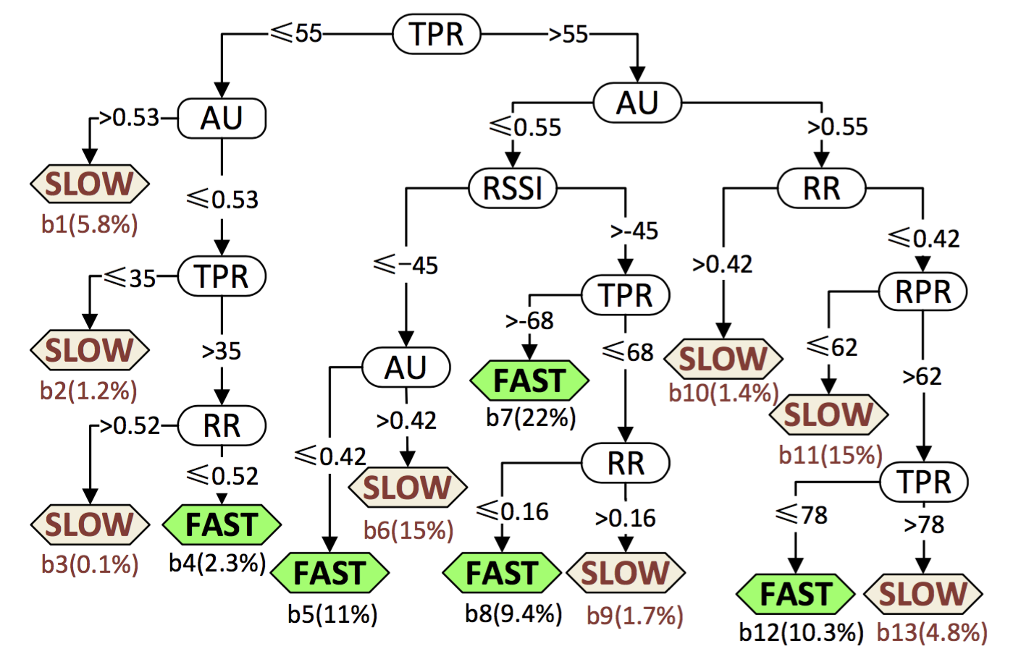
Decision Tree
Notes:
We tune the tree into six layers and we use this in the following optimization

Slide 36
Outline
Introduction
Methodology & Measurement
Analysis& Model
Optimization & Future Work

Slide 37
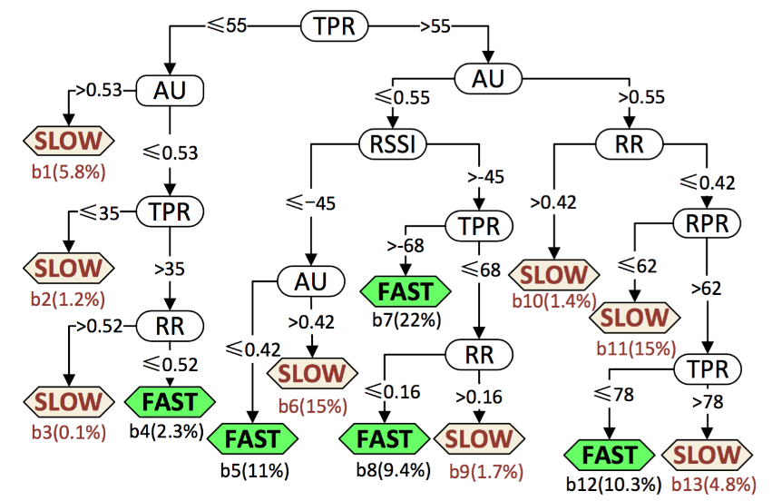
Three Steps for Optimization
Collect raw trace from the AP we want to diagnose and input them to the decision tree
Find the slow branch and locate the candidate for optimization.
Reconfigure the AP to change the value of certain split criterion.
Notes:
Here I first introduce the tree steps for optimization
1. Collect raw trace which contains WiFi factors which we want to diagnose and input them to the decision tree
2. Find the slow branch which has the largest number of samples. Trace the path to root of the tree, every split parameter can be potential candidate for optimization.

Slide 38
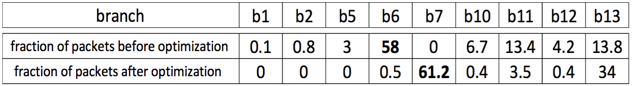
Case Study 1
TPR = 54Mbps
AU = 0.6
RSSI = -45
RR = 0.5
RPR = 6Mbps
TPR = 6 Mbps
AU = 0.3
RSSI = -45
RR = 0.5
RPR = 6Mbps
> 68Mbps
> 78Mbps
branch | B1 | B2 | B5 | B6 | B7 | B10 | B11 | B12 | b13
before
after
0.1%
0.8%
3%
58%
0
6.7%
13.4%
4.2%
13.8%
0%
0%
0
0.5%
61.2
0.4%
3.5%
0.4%
34%
Notes:
The first optimization is done on AP in the department which has high wifi latency all the day-time.
First we collect the trace and classify the trace as this two packets show. We do the same thing to other samples. The overall result show as follows
We find that

Slide 39
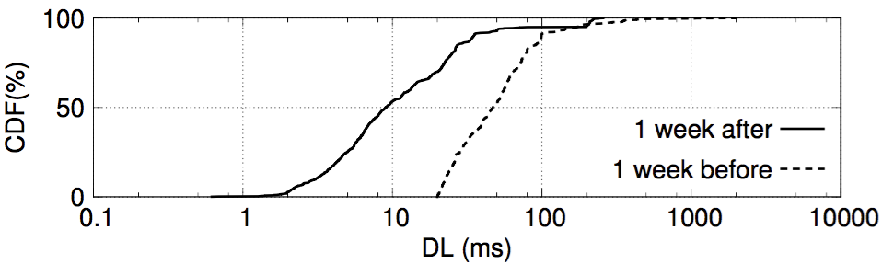
Case Study 1: Relocate the AP
10ms
50ms
CDF of OAP DL one week before and one week after optimization under the guidance of decision tree.
5X improvement!
Notes:
We draw the dl 1 week before and after the optimization

Slide 40
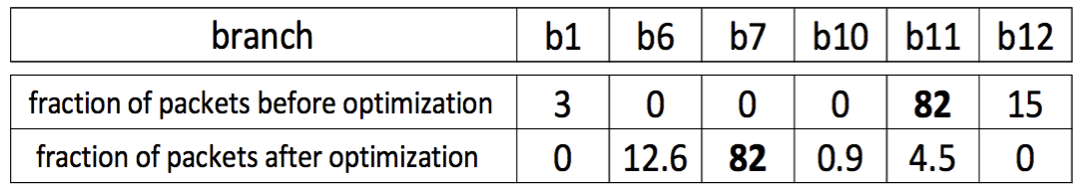
Case Study 2: Channel Switching
Notes:
Tree steps
The second optimization is done on the AP, whose user complain

Slide 41
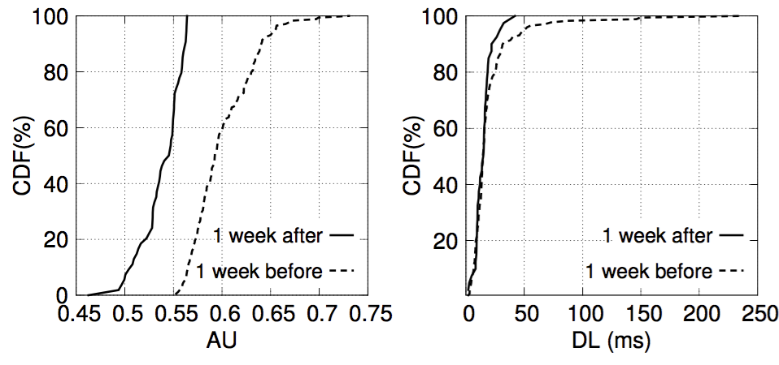
Case Study 2: Channel Switching
50ms
250ms
0.52
0.6
CDF of AU and DL one week before and one week after the channel selection.
Notes:
Tree steps
双向的箭头

Slide 42
Conclusion & Future Work
WiLy, which effectively breaks down the Round Trip Network Latency for the first time. NO client-side modification, OpenWrt-compatible.
Exhaustive measurement on 47 APs in the wild for two months
Provide a decision tree based model which can be used to diagnose the performance degradation and the optimization show good result.
This work can be further extended by: Delay ACK filtering, applying to dynamic channel selection …
Notes:
Propose a method called WiLy, which effectively breaks down the Round Trip Network Latency for the first time. Need not client-side modification. Can be deployed to any OpenWrt-compatible APs.
Present systematic study based on an exhaustive measurement on 47 APs in the wild for two months and present some interesting results.
Provide a decision tree based model which can be used to diagnose the performance degradation. The model show the most important factors and the optimization show good result.
This work can be further extended by: Delay ACK filtering, applying to dynamic channel selection, or more advanced machine learning method.

Slide 43
Thank you!
peich14@mails.Tsinghua.edu.cn
Notes:
需要亮点比较明确，主题突出。ppt要尽量能够做到colorful

Slide 44
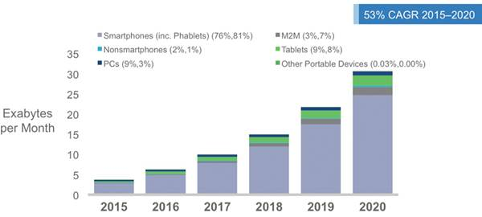
Abandoned pages
Figures in parentheses refer to 2015,2020 device share
Source: Cisco CNI Mobile,2016
The projected compound annual growth rate (CAGR)

Slide 45
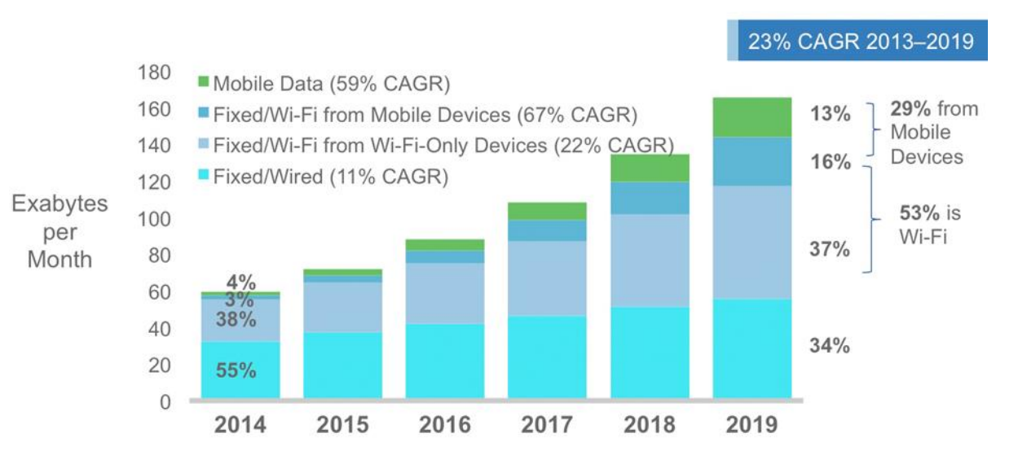
IP Traffic by Access Technology
Source: Cisco VNI Mobile, 2016

Slide 46
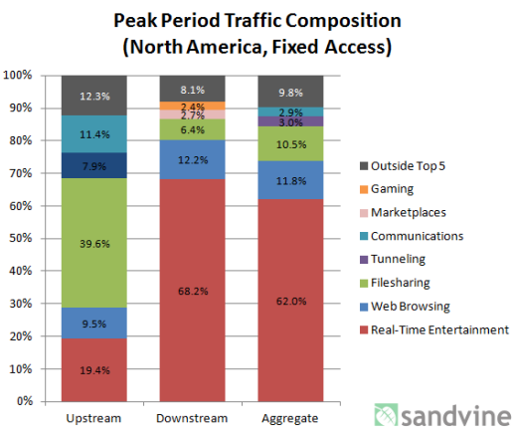
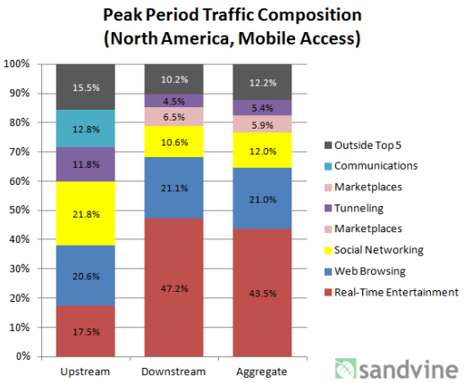
Notes:
https://www.sandvine.com/downloads/general/global-internet-phenomena/2013/sandvine-global-internet-phenomena-report-1h-2013.pdf

Slide 47
Possible questions:
Why the accuracy is so low?

Slide 48
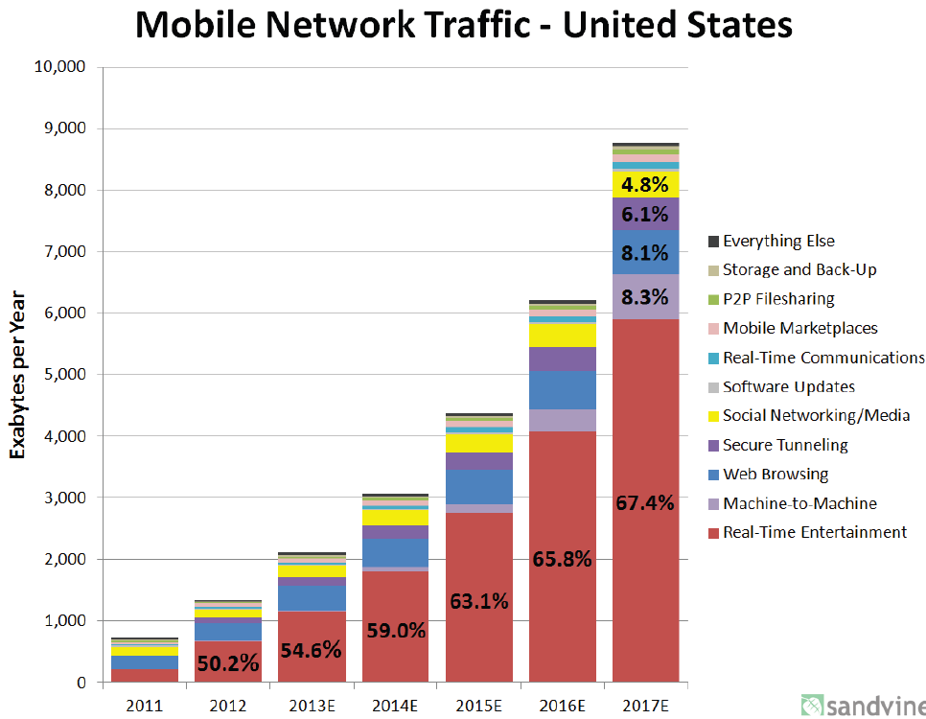
Many delay sensitive applications!
Real-Time Entertainment!
Sandvine 1H 2012 Report
Notes:
Mainly refer to the imc2013 dhcp paper:
Configuring DHCP Leases in the Smartphone Era
Important thing: whether the mobile traffic including the WiFi traffic? Does all the traffic generated on the Mobile devices is called Mobile traffic? It is better to find the portion of all traffic, not only mobile traffic

Slide 49
Gap between parameters and factors
…
Challenge: Metrics used to represent the current context/WiFi environment.
Transmit
Power
Airtime Utilization
Throughput
Channel
Retry
Ratio
RSSI
Location
Physical
Rate
Queuing
Length
Channel
Width
Notes:
列出是那些factors

Slide 50
Parameter-to-parameter dependencies
…
Higher RATE, Higher RETRY
Channel
Width?
Lower RATE , Less RETRY
Notes:
列出是那些factors

Slide 51
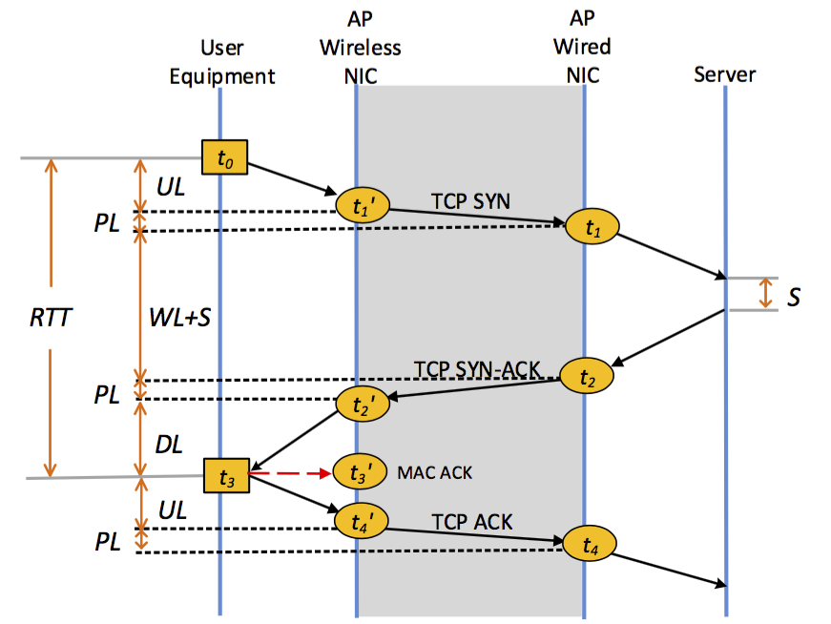
Three-way handshake packets
For all packets
PL is negligible
For three-way handshake packets
No delay-ack:
S is negligible
UL = t₄’- t₂’ - DL
WL = t₂’-t₁’

Slide 52
Measuring WiFi Hop Latency
User
Equipment
AP
Wireless
NIC
mon0
t₁’
t₂
t₃’
MAC ACK
-

